Slide 1


Session no. 21
Subject: Engineering Chemistry
Course Code: ETCH104
Program: B.Tech. CSE (Full Stack/IBM/DS) SEM-I
Faculty Name: Dr. Divyanshi Mangla
(Assistant Professor)
School of Basic and Applied Sciences

Slide 2

Table of Contents
Pre-requisite
Battery and its uses
Quiz
Support Material

Slide 3
Pre-requisite
Basic knowledge of Class 12th Chemistry
Electrode potential
Redox reactions

Slide 4
Course Outcomes
CO1 | Understand the methods for water hardness and the basics of boiler water treatment and analyze fuel calorific values and battery. | BTL2
CO2 | Explain the characteristics and working principles of different battery types and types of fuels. | BTL2
CO3 | Determine the differences between batteries and fuel cells and classify fuel cell types based on their components. | BTL4
CO4 | Identify between hard and soft water, solve the related numerical problems on water purification and emf and its significance in industry and daily life. | BTL3

Slide 5

Uses
Cordless Appliances
Transistors
Electronic Flash Units
Calculator

Slide 6
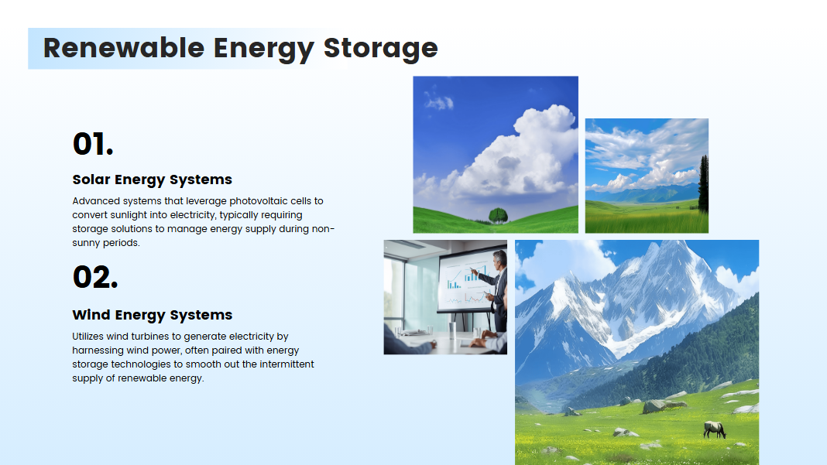

Slide 7
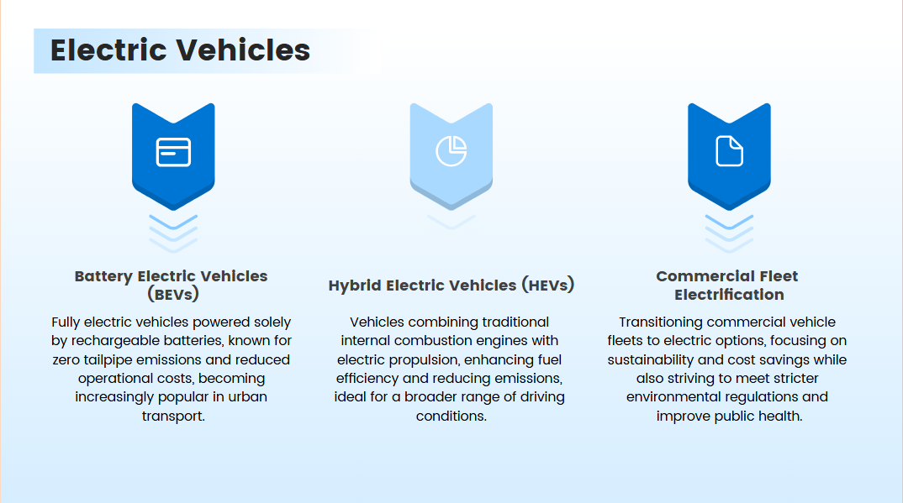

Slide 8
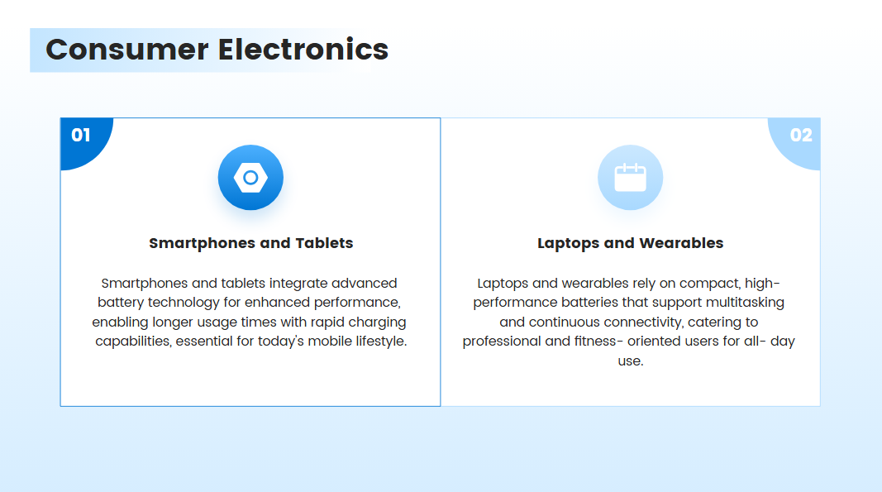

Slide 9
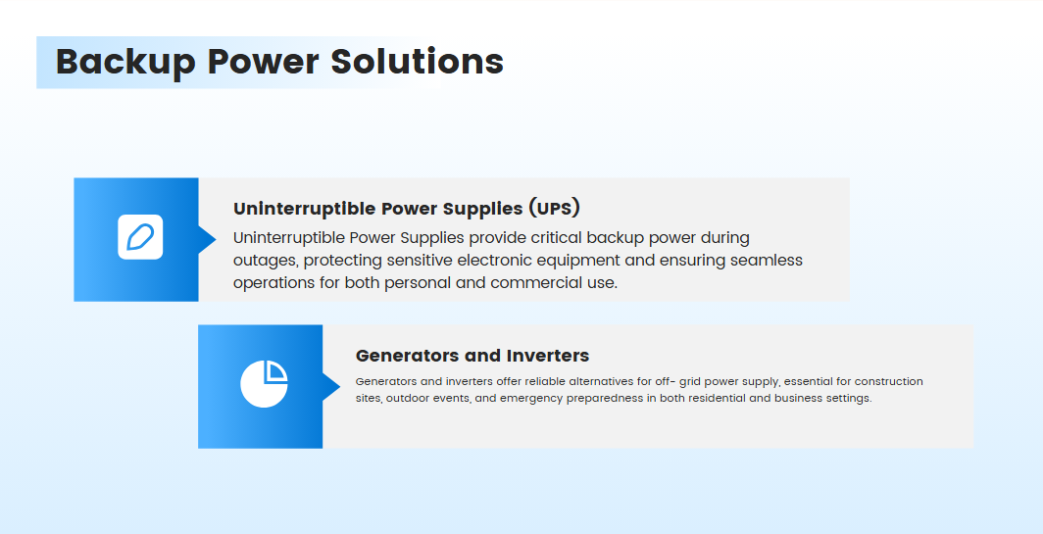

Slide 10
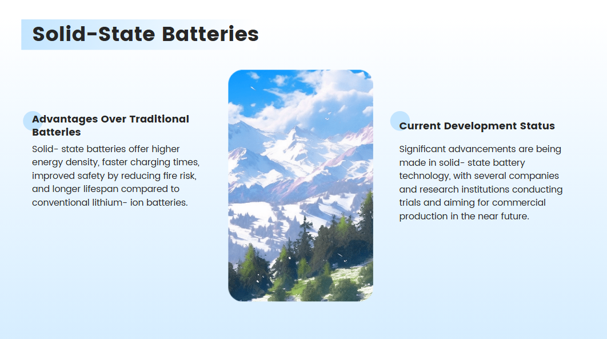

Slide 11
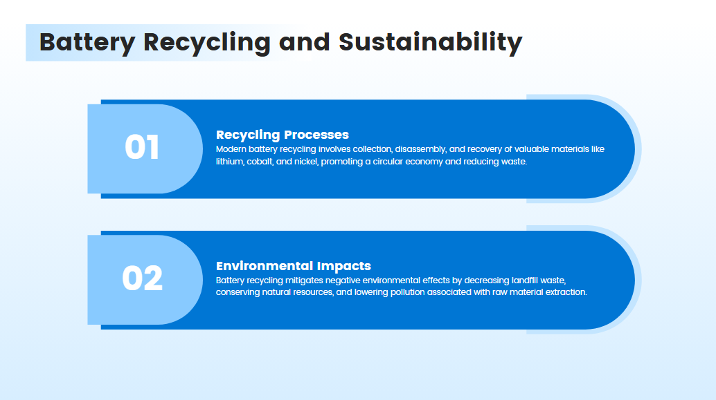

Slide 12
Q&A
🔹 Q1. MCQ
Which of the following batteries is most commonly used in automobiles? a) Lithium-ion battery b) Lead-acid battery c) Mercury battery d) Zinc-carbon battery
✅ Correct Answer: b) Lead-acid battery
🔹 Q3. Short Answer
Name two commercial sectors where Nickel-Cadmium (Ni-Cd) batteries are still in use.
✅ Answer:
Emergency lighting systems
Cordless power tools
🔹 Q2. MCQ
Which battery is most widely used in portable electronic devices like mobile phones and laptops? a) Nickel-metal hydride battery b) Zinc-air battery c) Lithium-ion battery d) Lead-acid battery
✅ Correct Answer: c) Lithium-ion battery
🔹 Q5. MCQ
Which battery type is commonly used in hybrid and electric vehicles? a) Mercury cell b) Zinc-carbon battery c) Lithium-ion battery d) Alkaline battery
✅ Correct Answer: c) Lithium-ion battery
🔹 Q4. Short Answer
Why are button cells used in watches and hearing aids? Mention one advantage.
✅ Answer: They are small in size, lightweight, and provide a steady voltage for low-power devices.

Slide 13
📚 Key Takeaways:
Lead-acid batteries are extensively used in automobiles, UPS systems, and heavy-duty equipment.
Lithium-ion batteries are the preferred choice for laptops, smartphones, EVs, and power tools due to high energy density and rechargeability.
Nickel-Cadmium (Ni-Cd) batteries are used in emergency lighting, medical devices, and aviation for their durability and performance under extreme conditions.
Alkaline batteries are widely used in remotes, clocks, toys, and flashlights because they are affordable and have a long shelf life.
Button cells (e.g., silver oxide, zinc-air) are compact batteries used in wristwatches, hearing aids, and small electronics.
Battery selection in commercial sectors depends on:
Power requirement
Size and portability
Rechargeability
Cost-effectiveness
Environmental safety

Slide 14
📚 Textbook References
Author(s) | Book Title | Publisher | Relevant Chapters/Pages
P.W. Atkins & Julio de Paula | Physical Chemistry | Oxford University Press | Chapter 19 – Electrochemistry (pp. 670–692)
K.L. Kapoor | Electrochemistry & Solutions (Vol. 3) | Macmillan India | Chapter 5 – Batteries (pp. 120–140)
Bahl & Tuli | Essentials of Physical Chemistry | S. Chand Publishing | Chapter 9 – Batteries and Fuel Cells (pp. 670–690)
Gurdeep Raj | Advanced Physical Chemistry | Goel Publishing House | Section: Storage Cells and Their Applications
Sharma & Kaur | Physical Chemistry | Krishna Prakashan | Chapter: Commercial Applications of Batteries

